Slide 1


Data science & Machine Learning in OBSERVABILITY
Walk behind the scene observability scenarios related to DS/ML
Notes:
We are not going to talk about general ML – classifying dog vs cats or image processing, we will focus on OBS related projects as examples for DS and ML

Slide 2


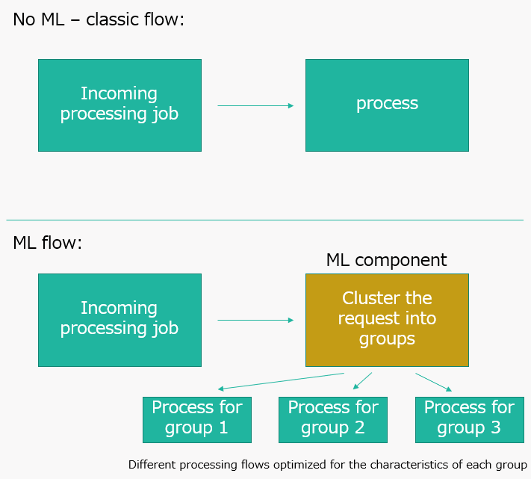
Pattern 1: improving services
Impacting internal service flow
For optimizing costs, latency, prevent incidents

Slide 3
Alert latency
Service experiences difficulty: Evaluating at time 0 might create mistakes(false alerts or missed alerts)
When to evaluate?
Collect statistics from different RP, region, etc.
Keep them updated live all the time
Run at 99% percentile/max to avoid mistakes (accuracy)

Slide 4
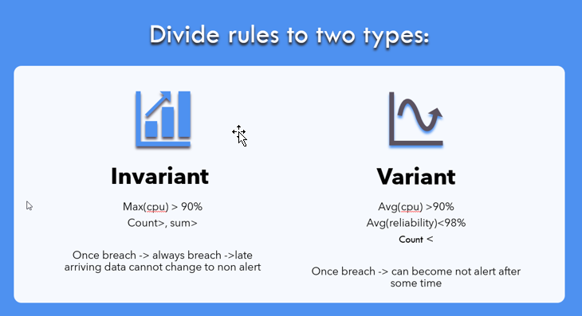
Clustering: grouping together by common characteristics

Slide 5

why ML?
Syslog| where au_type_CF == "SYSCALL"| project TimeGenerated, Computer, HostIP, au_event_timestamp_CF, au_event_id_CF, au_key_CF, msg_syslog=SyslogMessage, au_arch_CF, au_syscall_CF, au_success_CF, au_exit_CF, au_items_CF, au_ppid_CF, au_pid_CF, au_auid_CF, au_uid_CF, au_gid_CF, au_euid_CF, au_suid_CF, au_fsuid_CF, au_egid_CF, au_sgid_CF, au_fsgid_CF, au_tty_CF, au_ses_CF, au_comm_CF, au_exe_CF, au_subj_CF, au_type_CF| join kind= leftouter( Syslog | where au_type_CF == "EXECVE" | extend cmd = extract("argc.*", 0, SyslogMessage) | project au_event_timestamp_CF, au_event_id_CF, msg_execve=SyslogMessage, cmd)on au_event_timestamp_CF, au_event_id_CF| project-away au_event_timestamp_CF1, au_event_id_CF1| join kind= inner ( Syslog | where au_type_CF == "CWD" | project au_event_timestamp_CF, au_event_id_CF, msg_cwd=SyslogMessage, au_cwd_CF)on au_event_timestamp_CF, au_event_id_CF| project-away au_event_timestamp_CF1, au_event_id_CF1| join kind= inner ( Syslog | where au_type_CF == "PROCTITLE" | project au_event_timestamp_CF, au_event_id_CF, msg_proctitle=SyslogMessage, au_proctitle_CF)on au_event_timestamp_CF, au_event_id_CF| project-away au_event_timestamp_CF1, au_event_id_CF1| join kind= inner ( Syslog | where au_type_CF == "PATH" | where au_item_CF == 0 | project au_event_timestamp_CF, au_event_id_CF, msg_path=SyslogMessage, au_item_CF, au_name_CF)on au_event_timestamp_CF, au_event_id_CF| project-away au_event_timestamp_CF1, au_event_id_CF1 | join kind= leftouter ( Syslog | where au_type_CF == "PATH" | where au_item_CF == 1 | project au_event_timestamp_CF, au_event_id_CF, msg_path=SyslogMessage, au_item_CF, au_name_CF)on au_event_timestamp_CF, au_event_id_CF| project-away au_event_timestamp_CF1, au_event_id_CF1 | join kind= leftouter ( Syslog | where au_type_CF == "PATH" | where au_item_CF == 2 | project au_event_timestamp_CF, au_event_id_CF, msg_path=Sys
Notes:
Classic non increasing example – how many machines did not send a health signal the past 5 minutes?

Slide 6
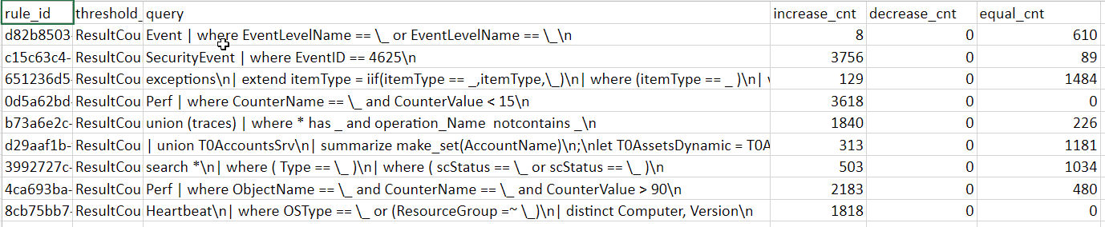
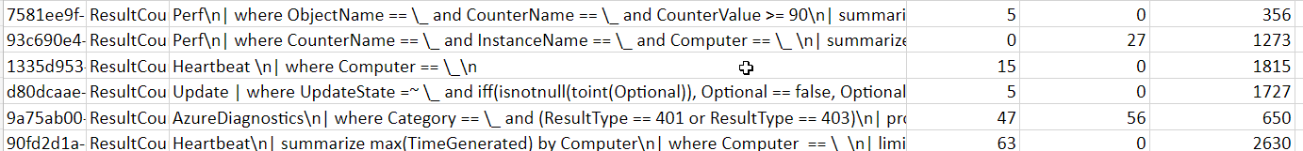
How?

Slide 7

Work process: Steps in building a model
Write a script (python) to collect increase decrease statistics based on the results.
Anonymize the queries text (data privacy issues).
Lebel each query as increasing/decreasing /both.
Break the queries into tokens (key words, bi-grams- tri grams) bag of words.
Create a model that provided an anonymized query predicts the label.
Analyze model results and perfect.
Notes:
This is what my team does in practice.
The first step is identifying the need which I normally do myself with the PM/engineering lead. To find the clusters and proper behavior.

Slide 8
How does a model learn to predict?
We provide a model with a set of examples: input and desired results (increasing/decreasing)
We define a loss function –
The sum of all errors for discrete answer.
The distance of the score from the desired result (if desired answer is 1 -> 0.4 result is better than 0.2)
We define set of features – “characteristics” for each query – in this example set tokens appearing in the query. This is formatted in a vector form.
There are different model structures – in this case RFT (random forest):
Answer 0 to all the queries. Compute the loss.
Find the feature which will best improve my score if I use it. If (feature>val) then predict 1 instead of 0.
Continue repeatedly building/splitting the tree
Create many such predictive trees – each one output a score (0-1) of how sure it is a decreasing query.
use the avg score of those tress.

Slide 9
More aspects/expertise of DS team:
How to select the features correctly
Train/test to avoid overfitting
Model evaluation
Retrain when new data (example: activity log alerts to be added to log search alerts service)

Slide 10
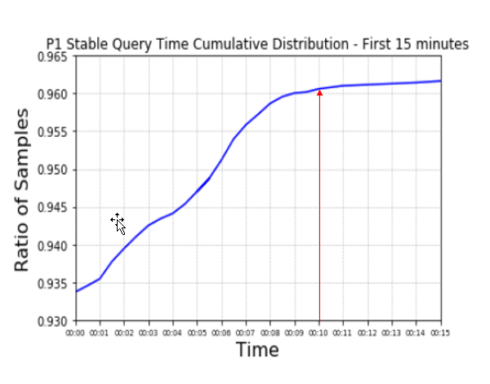
Strategy layer
When model gives results – example: 0.76% sure the alert is invariant
How to ACT on the result
Prefer errors toward invariant (safer flow)
Invariant – run in alert intervals (frequency) evaluate current window + past windows.
Variant – consecutive 2
Analyze histogram of latency
Provided one evaluation ended in “alert” wait for 2 minutes to additional data to arrive.
Compare results to reduce error rates
Strategy layer is key component in the success of applying the model

Slide 11
Profile of a DATA scientist
Mastering math, statistics and probability theory
Coding skills – usually CS background - Writing code to extract and manipulate data
different from MSR – we are applied team focused on production impact
Skilled in ML / DS domain
Msc/Phd in the field
Published articles – proficient in reading background material understand how to implement and relevance
Team structure:
2 DS in my team.
2 students(interns)
Work processes
More experimental
Requires delicate balance of creativity with data driven measurable framework

Slide 12
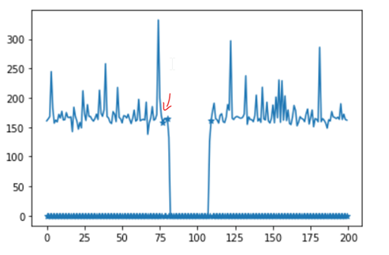
4 projects on the go now
LA query prediction integration
Cpu consumption of query analysis – time span extraction
Recall verified.
Smart map – Milestone 1 integration
Container Insights
Right sizing
Deployment insights (?)
Dynamic Thresholds –
Outage removal
Customer facing AI tools (1p+3p)

